Slide 1
Project Presentation
Submitted By :- Pavan Gupta (201500467)
Kshitij Varshney (201500356)
Prabhu Awasthi (201500479)

Slide 2
positivae
E-commerce website​

Slide 3
AGENDA
Introduction​
Primary goals
​Areas of growth
Timeline
​Summary​

Slide 4
Introduction
We have taken over this project of developing a website for clothing products dealer to help him make profits in the earning and provide the customers the features that can ease their problems regarding what to buy.

Slide 5
PRIMARY GOALS
To Provide Ease in shopping and selling.
We have created a basic structure of website so that anyone can use it.

Slide 6
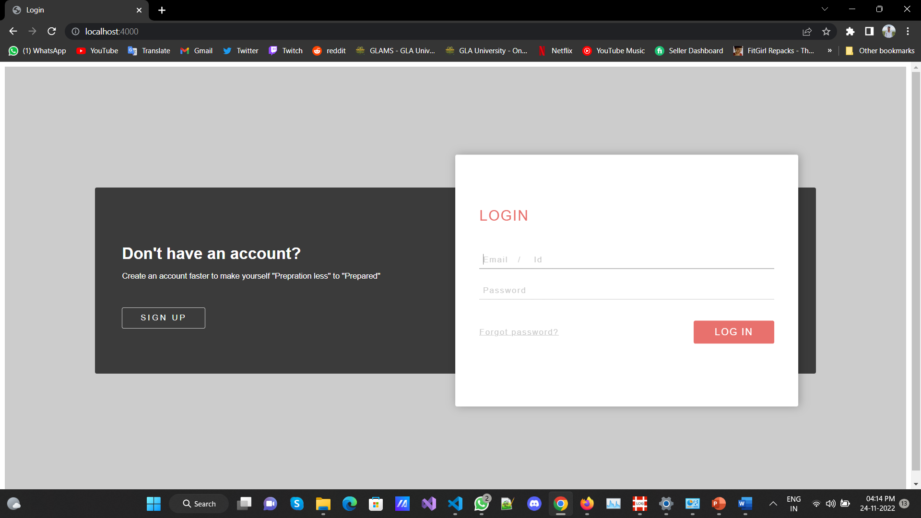
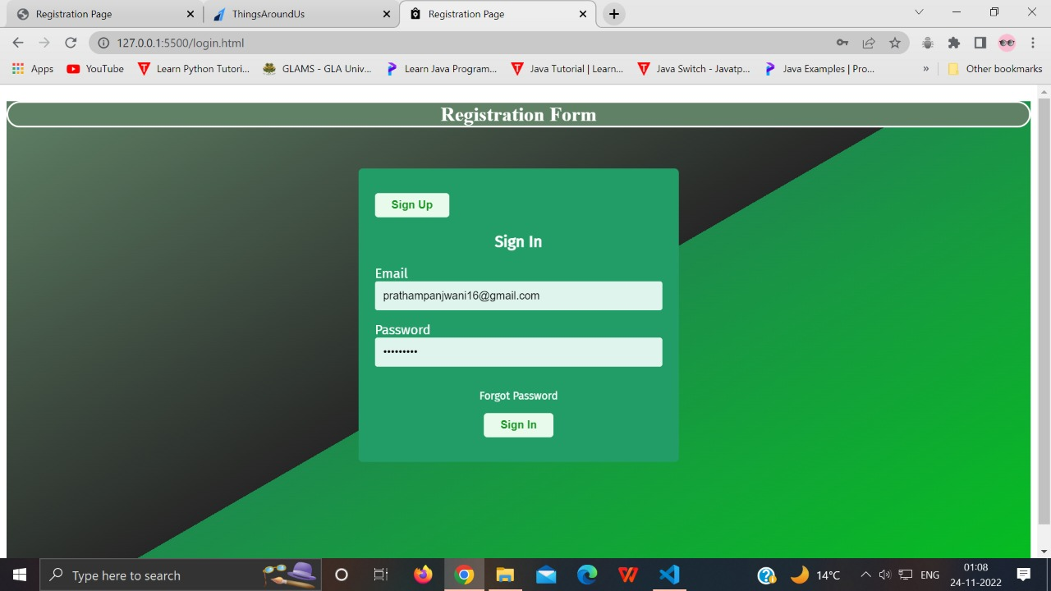
Login/Sign Up page
We have Created a creative sign up page with the help of CSS.
We have also linked it with Mongo database , we faced problems but eventually we did it.

Slide 7
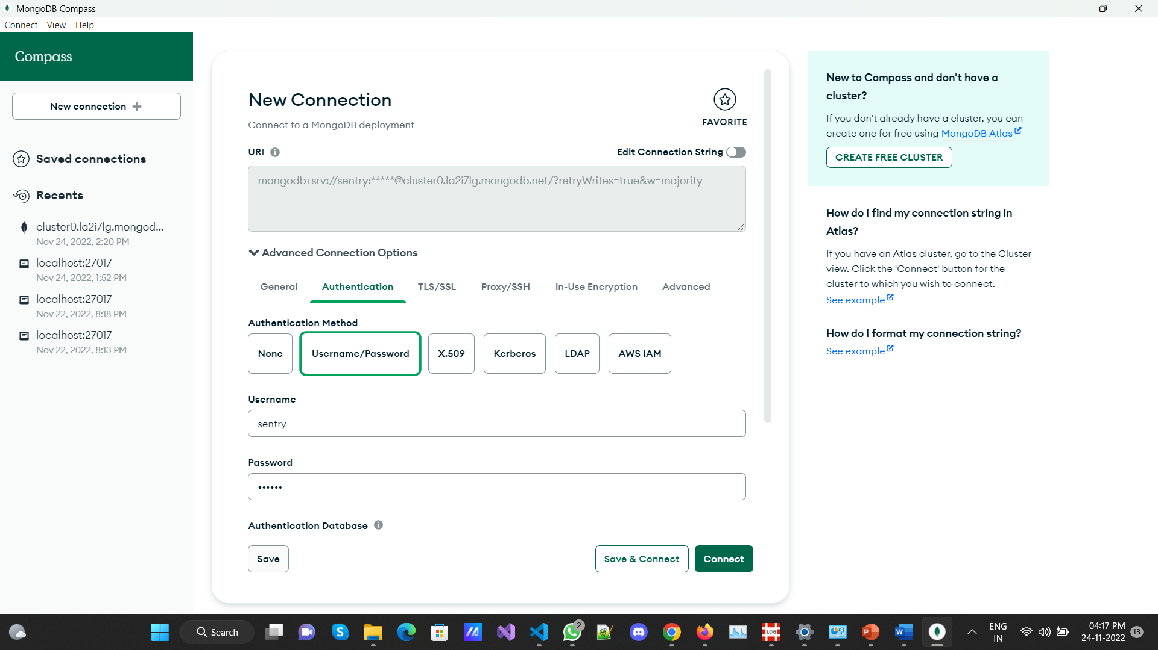
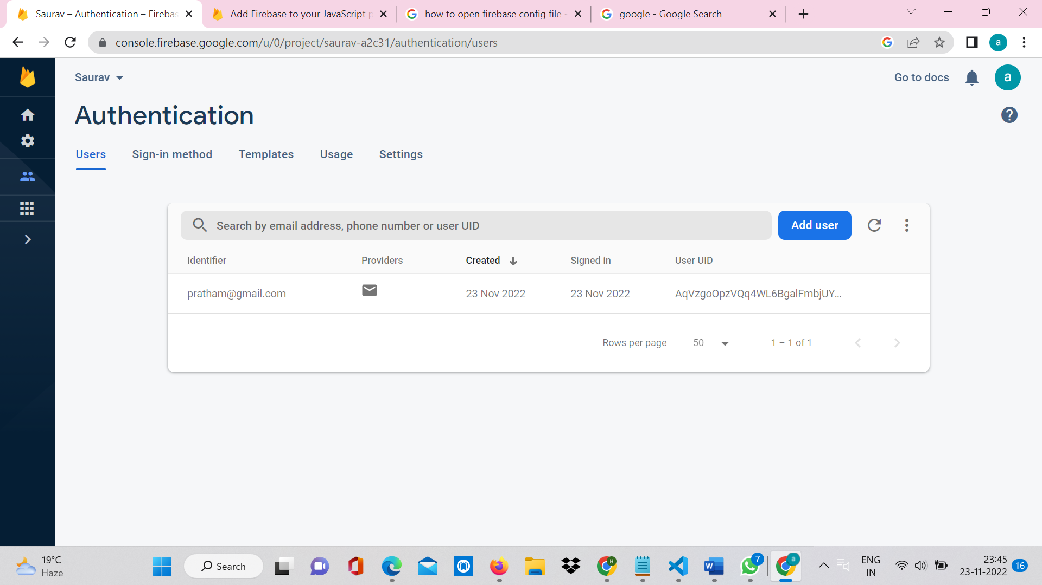
Database
We have linked it with MongoDB
And the data has been stored there.
Email,passsword,etc
We also implemented mailer system to verify the authenticity of E-mail.

Slide 8
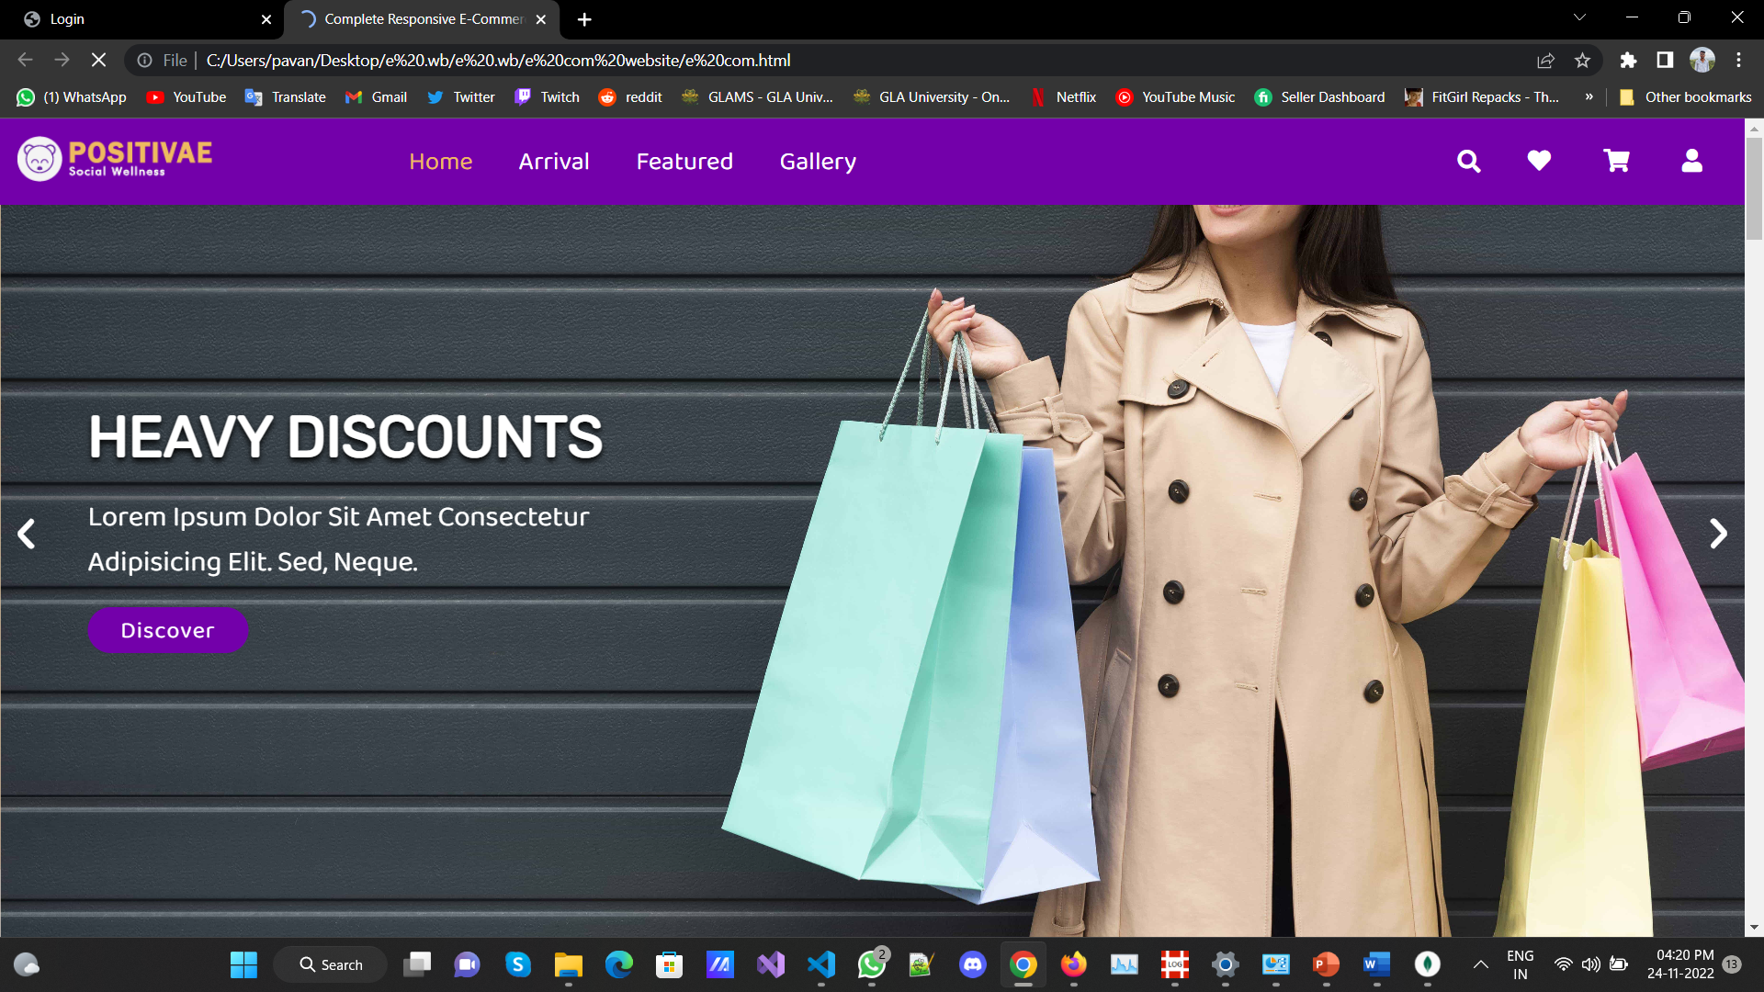
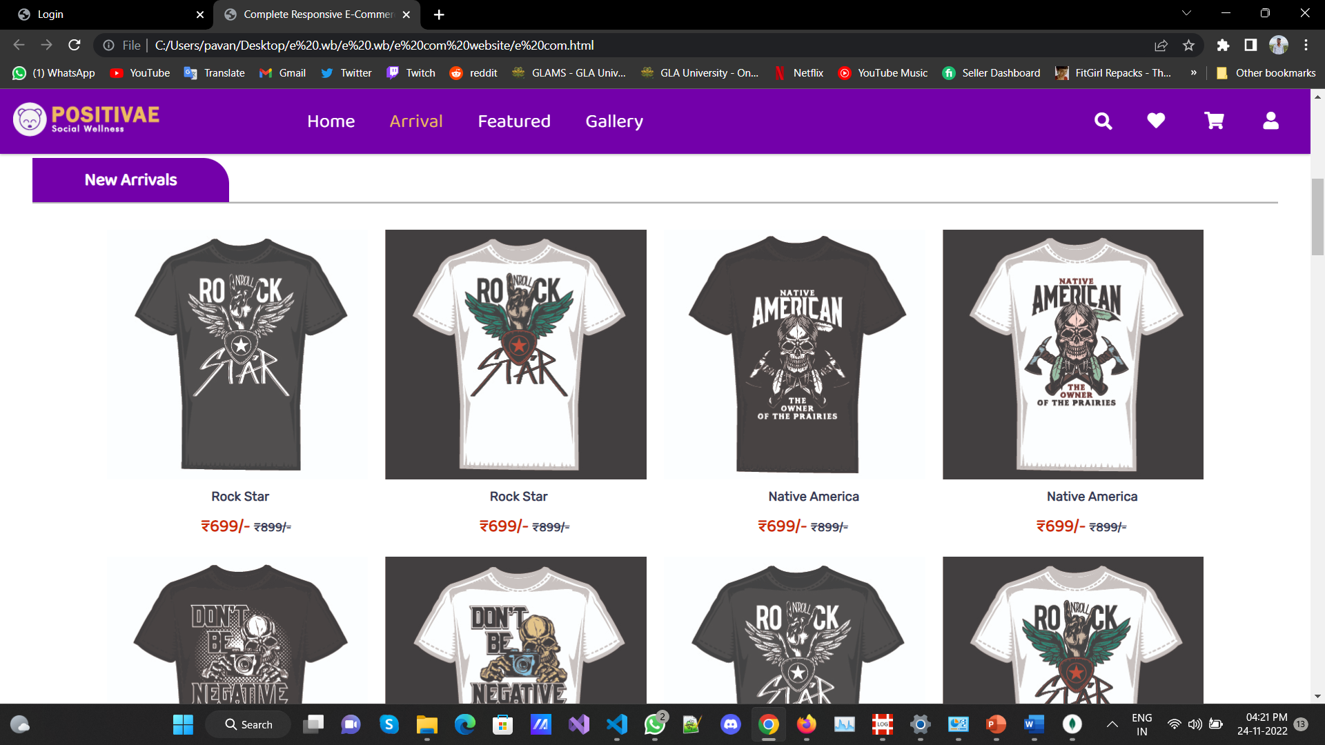
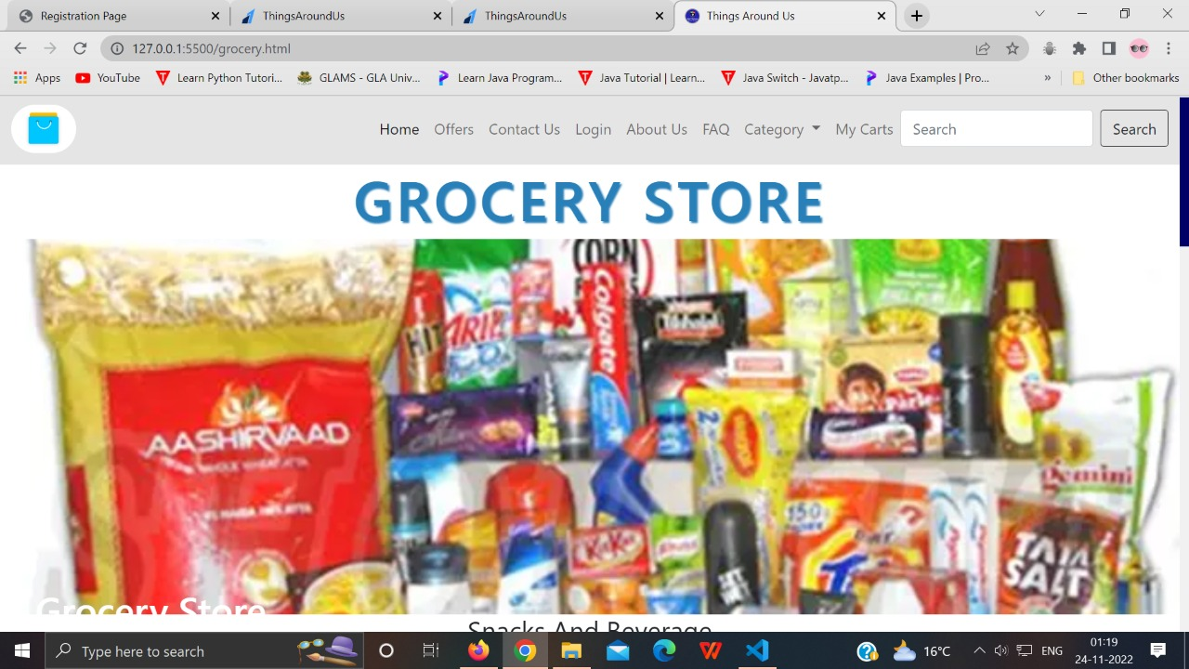
categorized selling pages
We have Created a categorized selling pages like grocery, books,furniture,etc.
when we move to those page we will get to know about various product listed on website
You would also get discount which you can see from offer page

Slide 9
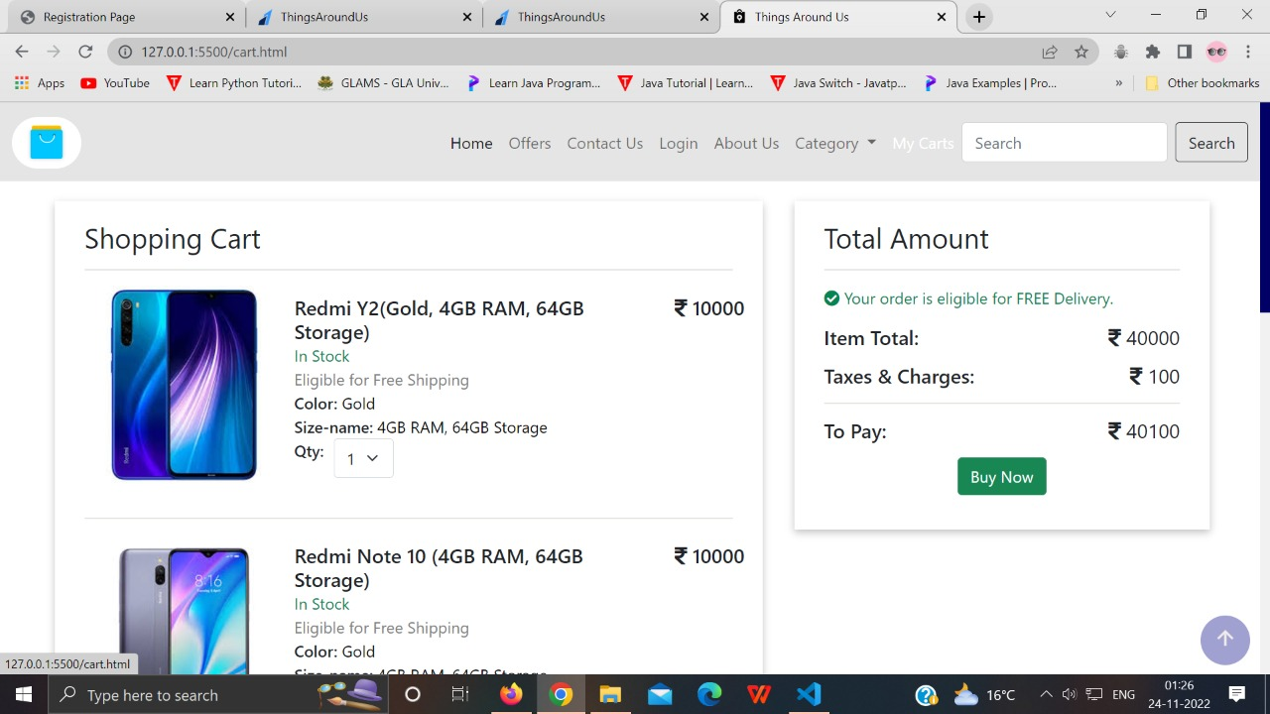
Cart Page
When you add things to your cart
It will redirected you to card page
Where add quantity of the product.
And when to click payment (buy Now)
It will redirected you to the payment page.

Slide 10
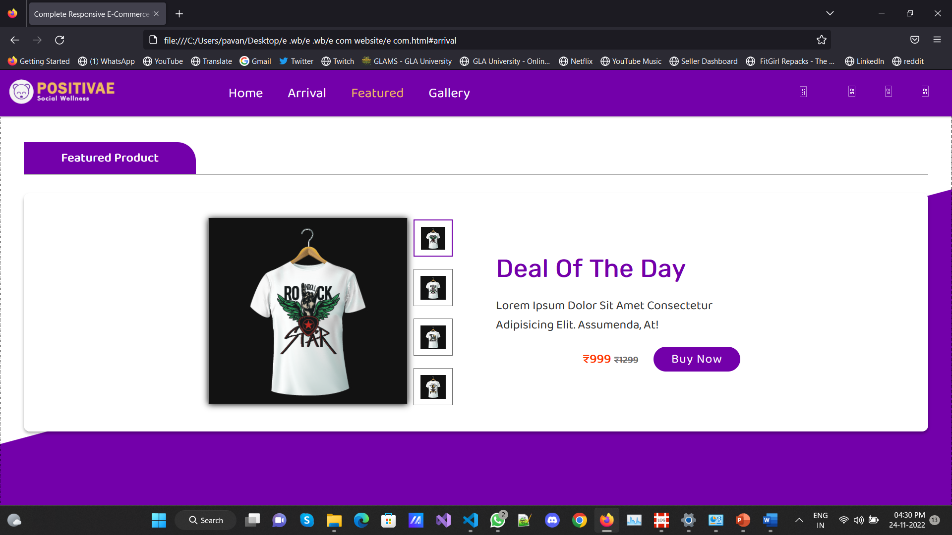
DEAL OF THE DAY !

Slide 11
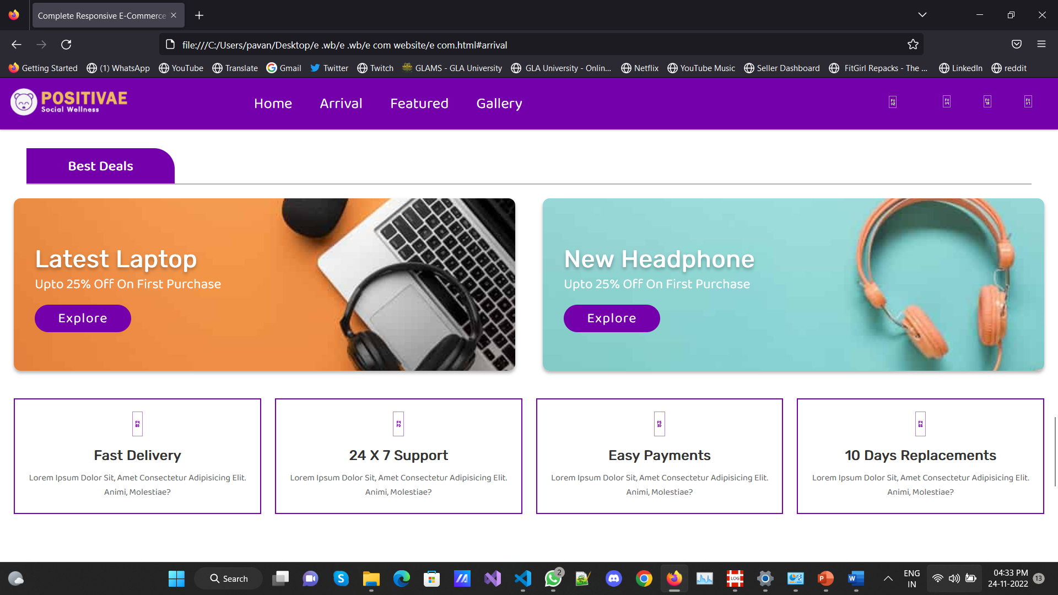
BEST DEALS !

Slide 12
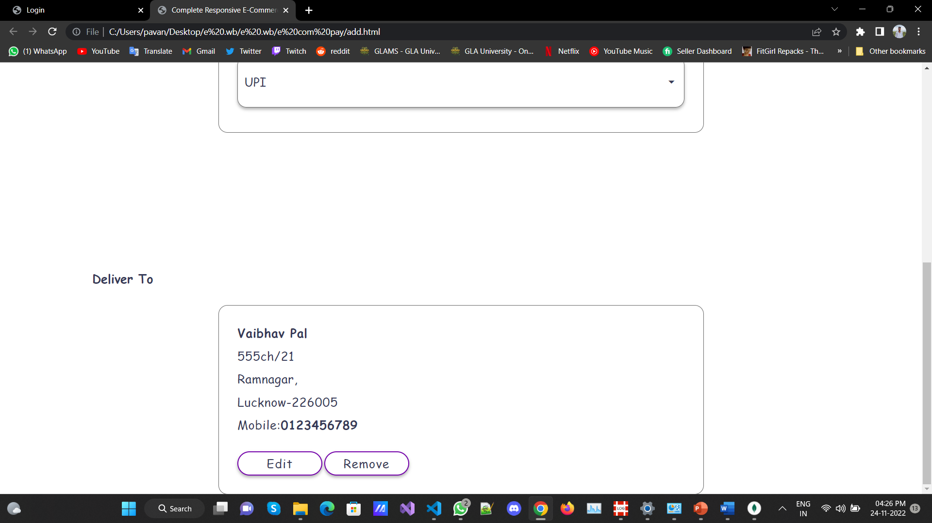
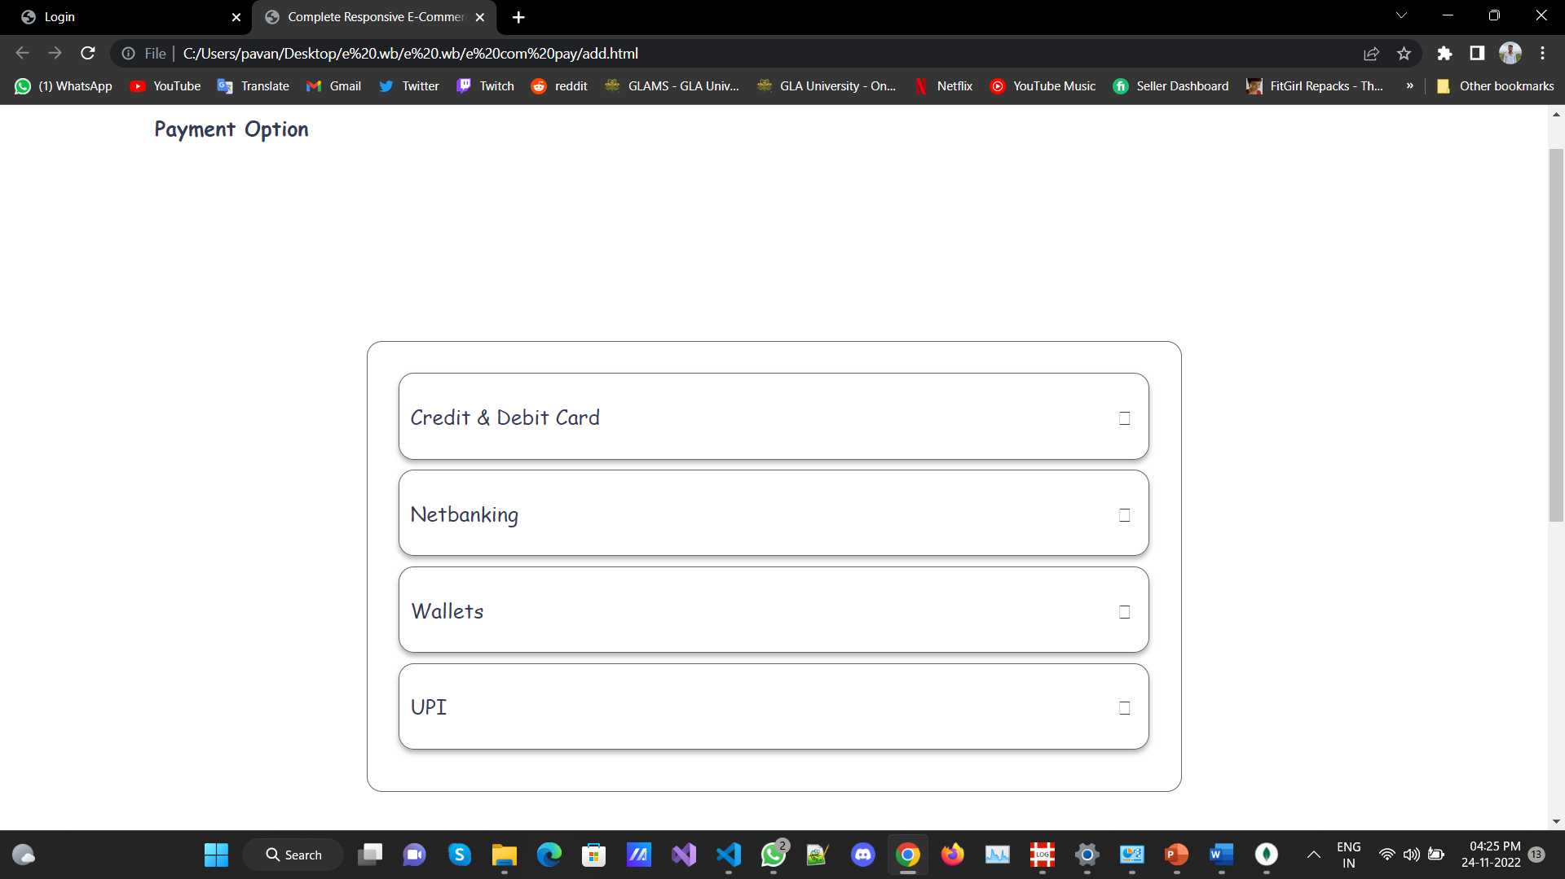
Payment Page

Slide 13
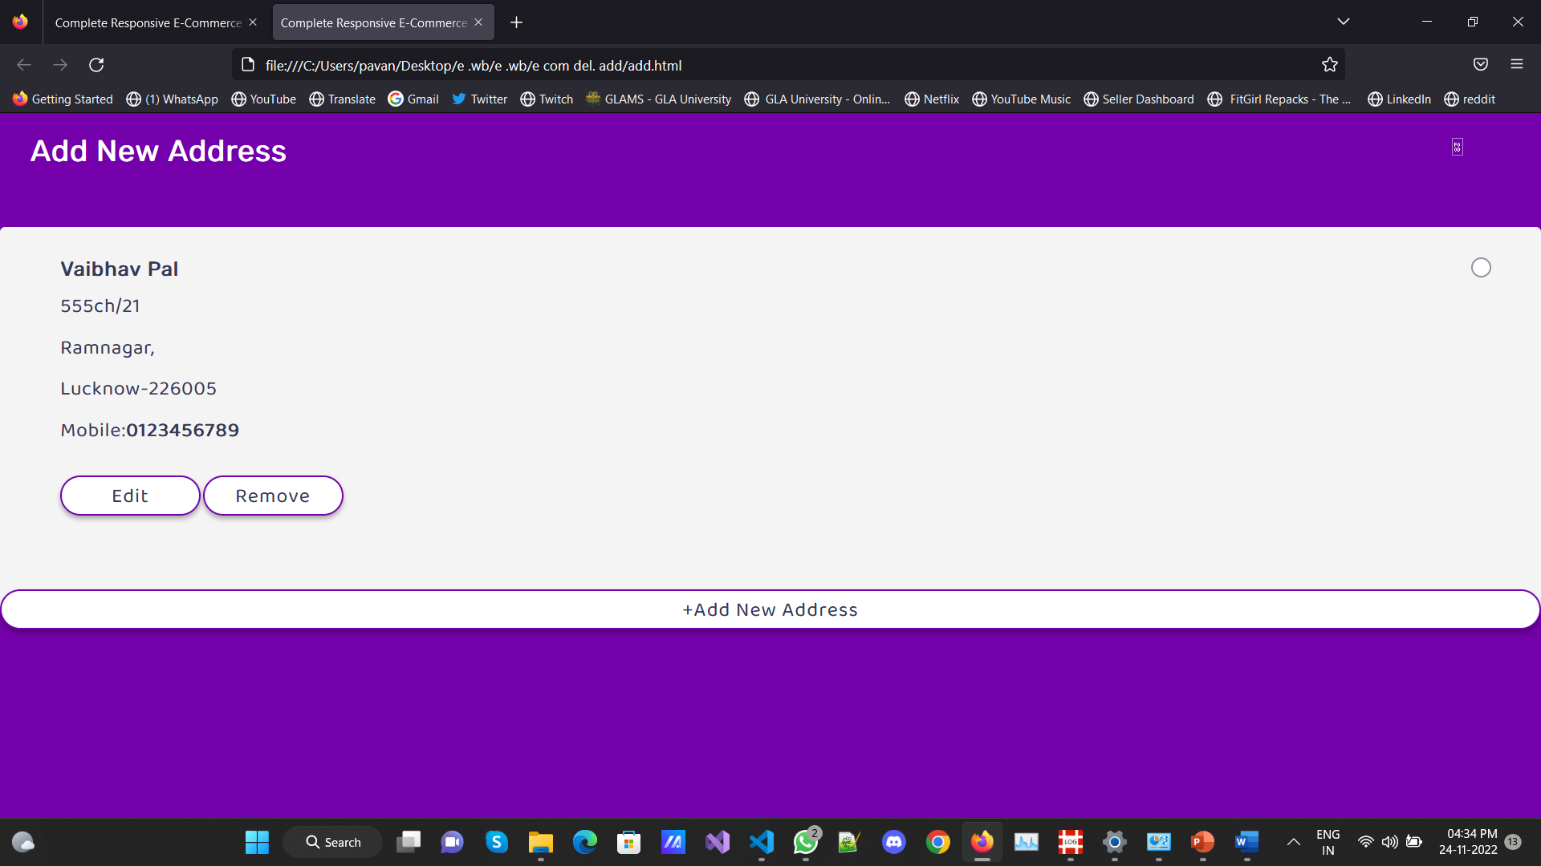
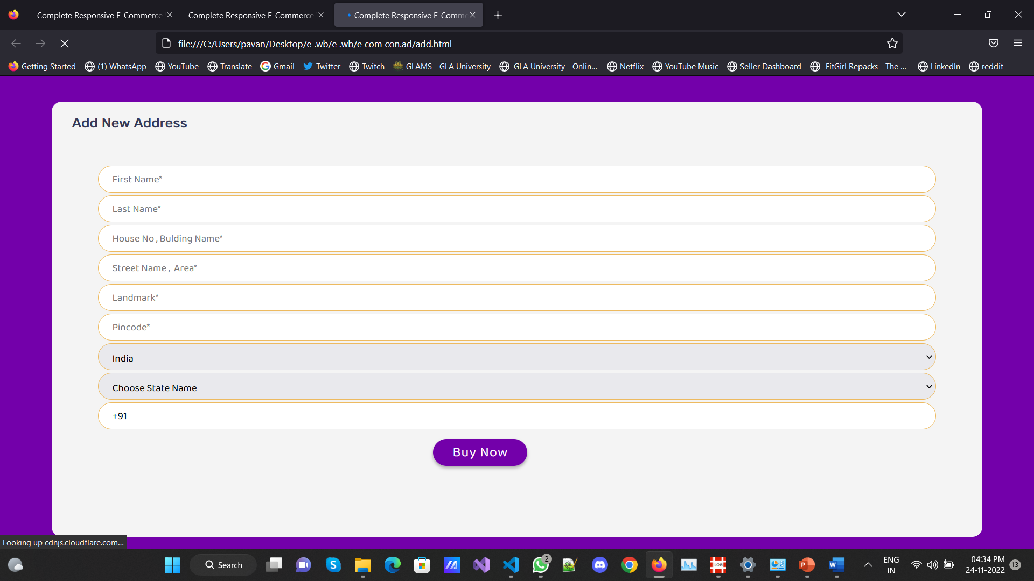
DEL/ADD ADDRESS

Slide 14
BUSINESS OPPORTUNITIES ARE LIKE BUSES. THERE'S ALWAYS ANOTHER ONE COMING.
“
”
Richard Branson

Slide 15
SUMMARY
This project is only a humble venture to satisfy the needs in a shop. Several user friendly coding have also been adopted. This package shall prove to be a powerful package in satisfying all the requirements of the organization. The objective of software planning is to provide a frame work that enables the manger to make reasonable estimates made within a limited time frame at the beginning of the software project and should be updated regularly as the project progresses.

Slide 16
THANK YOU

